Slide 1
Mad Mad world
By Mina Anis and Dan Mackey

Slide 2
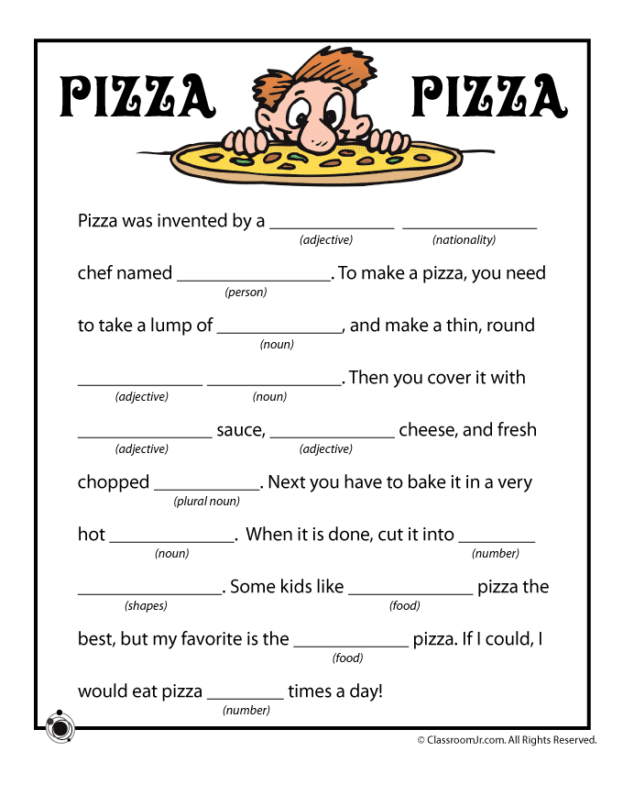
What are madlibs?
Mad Libs are stories with words removed and replaced by blank spaces.
One player “reads” to the other players and asks them to fill in blanks, with the only guidance they receive being what the word is(noun, pronoun, adjective, etc).
The words are then inserted into the story and lols are had.

Slide 3
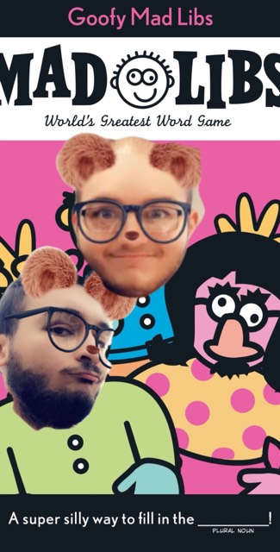
What we did
We took some of our favorite passages from throughout the years and made it into a MadLibs style game, with our own twist.
Instead of there being pre designated blank spots for words to be placed, the user can select how many of each word type they’d like to change and then give us some words and the program does the rest.

Slide 4

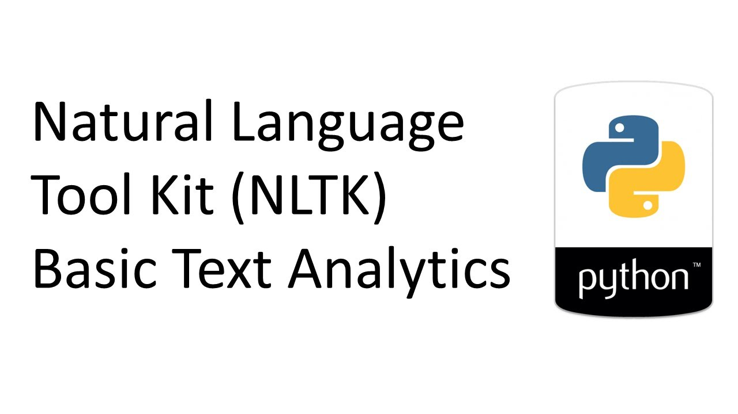

How this is relevant
Our program has a set of pre-selected passages, and upon user selection of the passage the program will read through it.
With the help of the NLTK library, along with some fiddling on our parts it will determine how many Nouns, Pronouns, Verbs, Adverbs, and Adjectives are in said passage.
Without the use of the NLTK this program would be incredibly tedious to do.

Slide 5
conclusions
Natural Language is a very interesting topic
Our project, while successful still leaves some room for potential improvements.
Some of these improvements include a user interface, and not printing out a space after every word in the passage.
Besides that our project is lit.

Slide 6
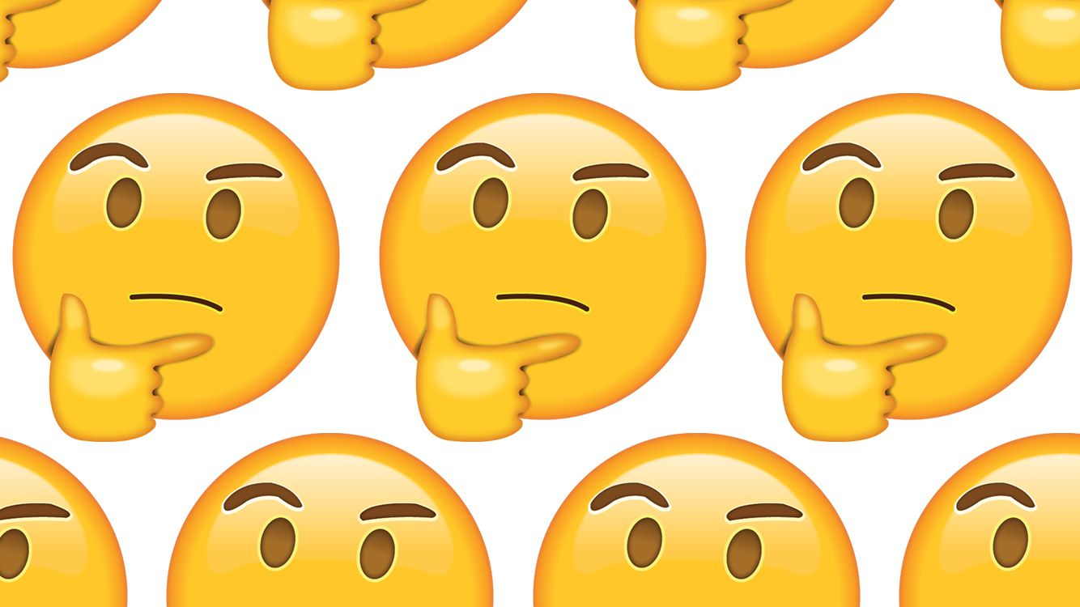

Questions?

